Slide 1

به نام يگانه پروردگار

Slide 2
Obesity
Prevalence and Impact of COVID-19
Davood Khalili, MD, MPH, PhD
Department of Biostatistics & Epidemiology
Research Institute for Endocrine Sciences
Shahid Beheshti University of Medical Sciences

Slide 4
Middle East and north Africa have the highest risk of metabolic diseases of all women globally, whereas men rank second of all men in this respect.
Metabolic risk factors are responsible for more than 300 deaths per 100 000 individuals in this region, compared with a global mean of fewer than 250.

Slide 5
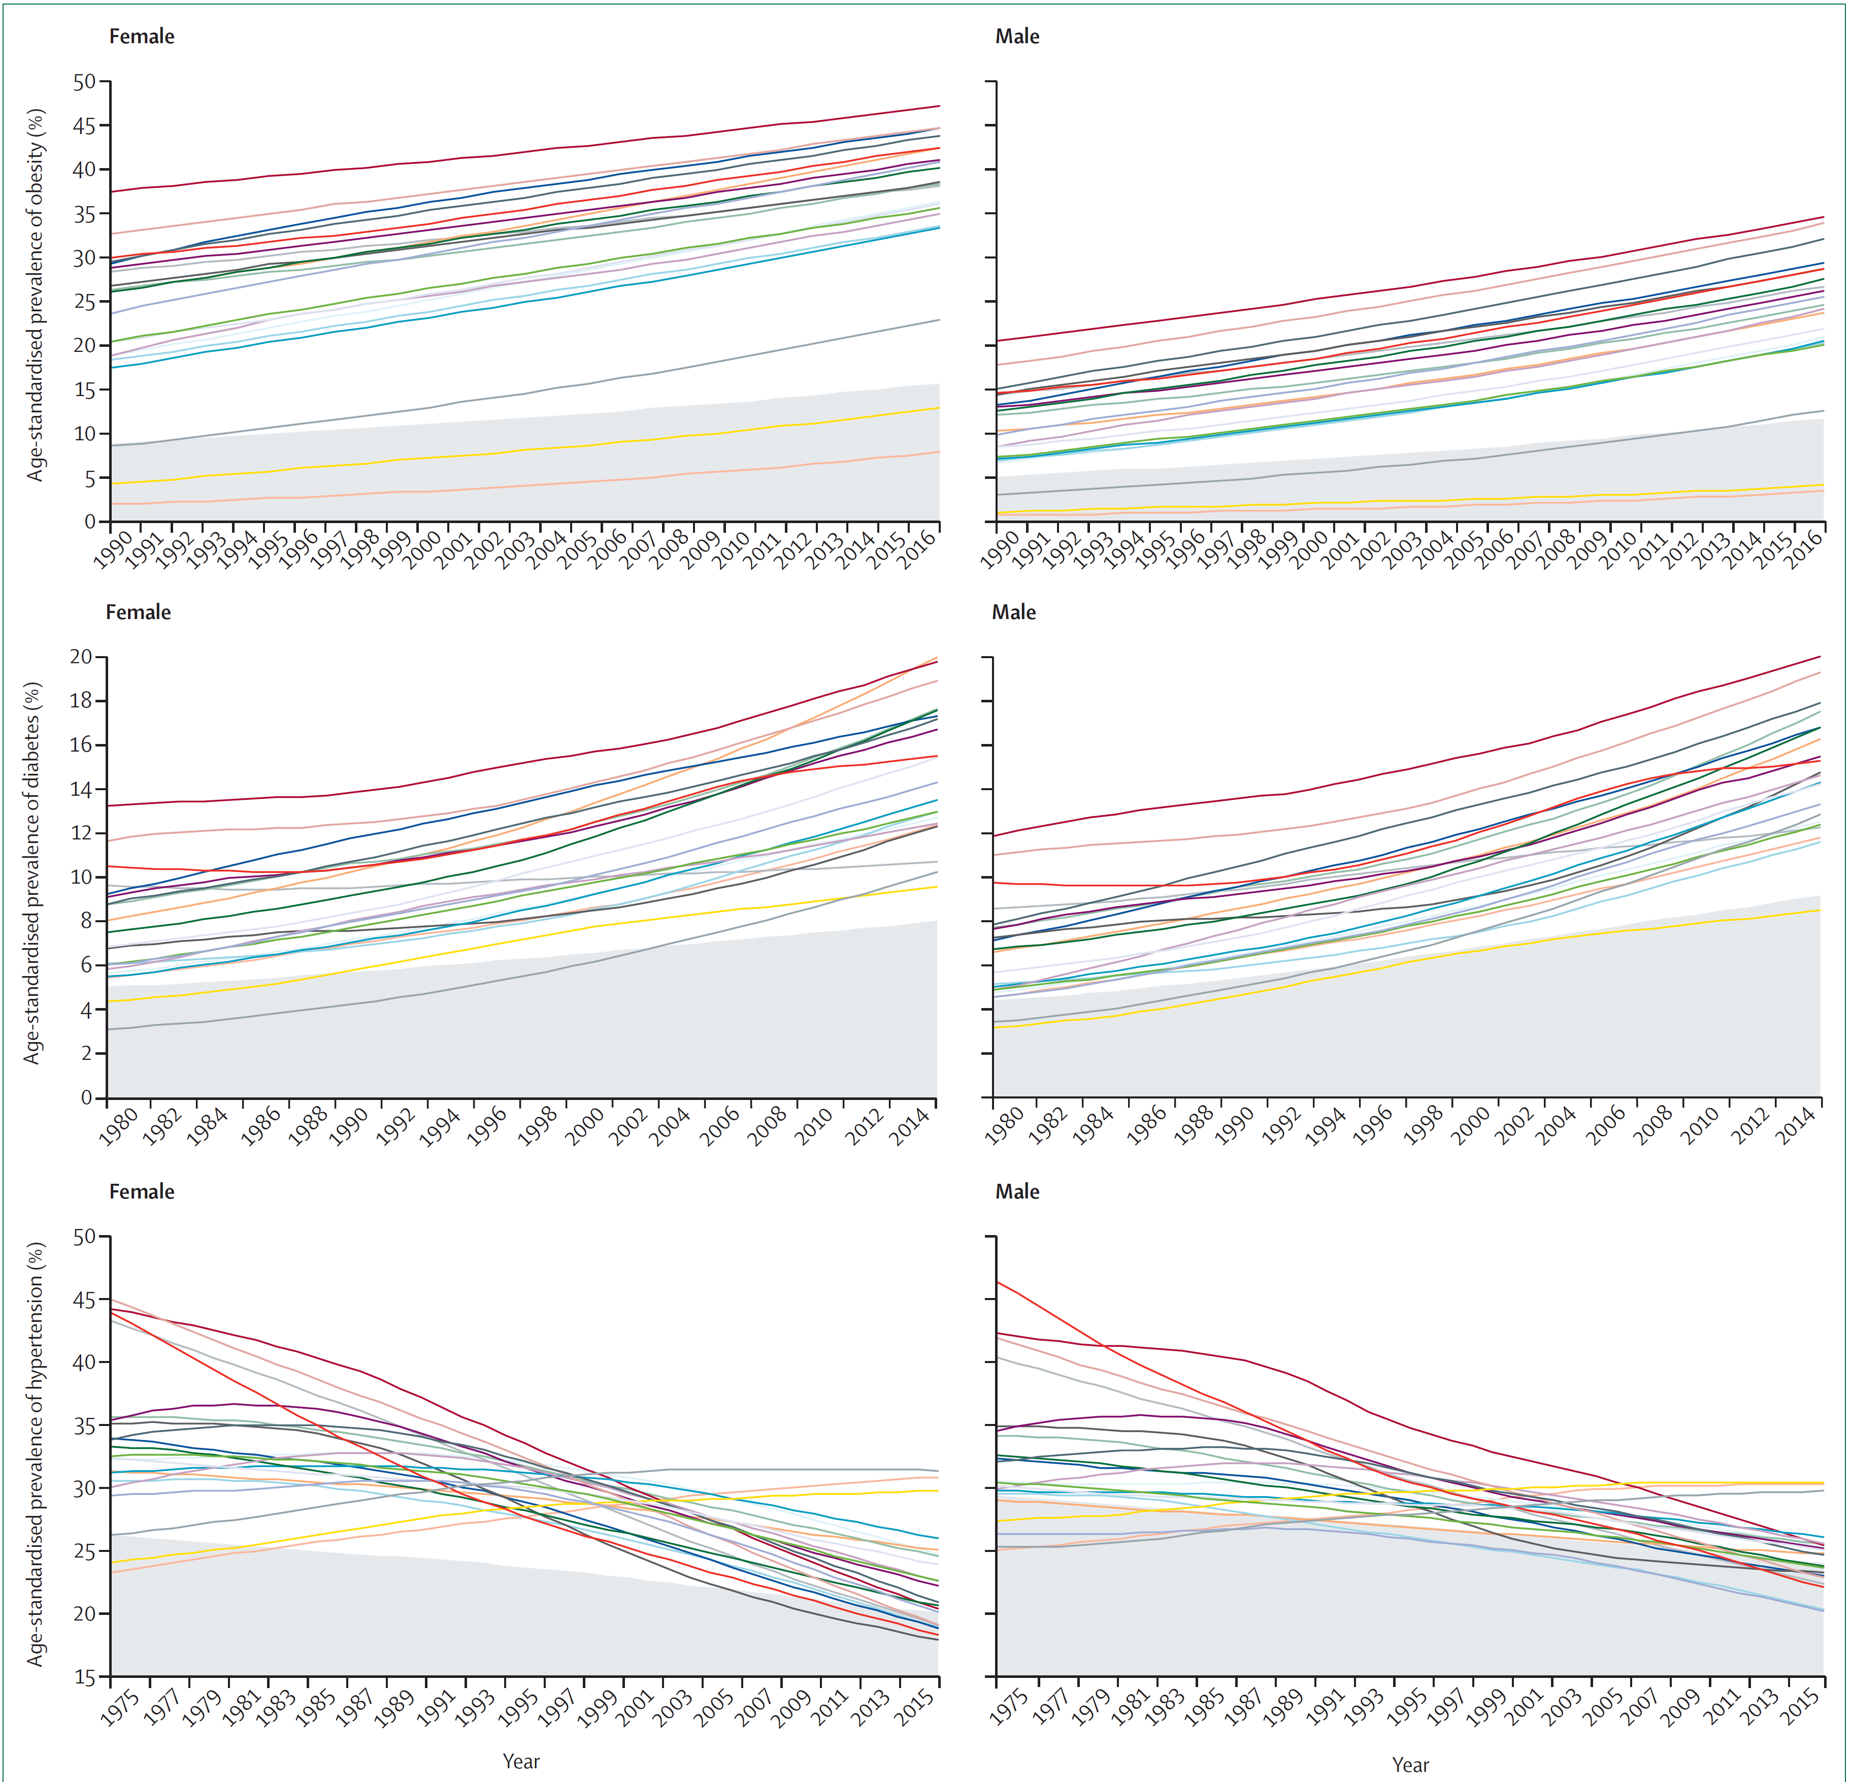
Prevalence of obesity, diabetes, and hypertension since 1975 by countries in the Middle East and north Africa

Slide 6
Observed/Expected of metabolic risk factors in the Middle East and north Africa by country.

Slide 7
Projection for age-standardised prevalence of high BMI and high FPG

Slide 8
Projection of obesity prevalence in 2025 and the probability of meeting the global target by country.

Slide 9
Achievement scores from WHO’s 2017 Non-communicable Diseases Progress Monitor report for different areas of national preventive programs.

Slide 10
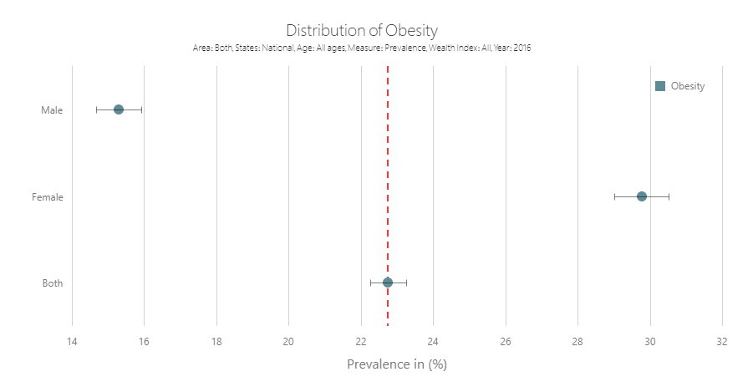
https://vizit.report/panel/steps/

Slide 11
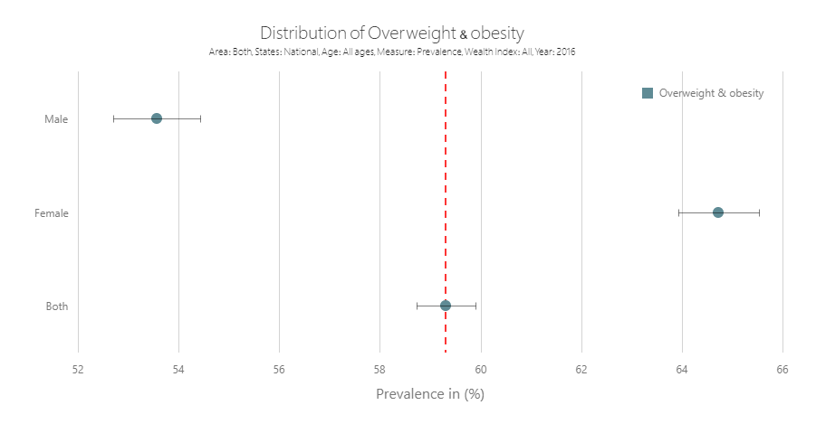

Slide 12
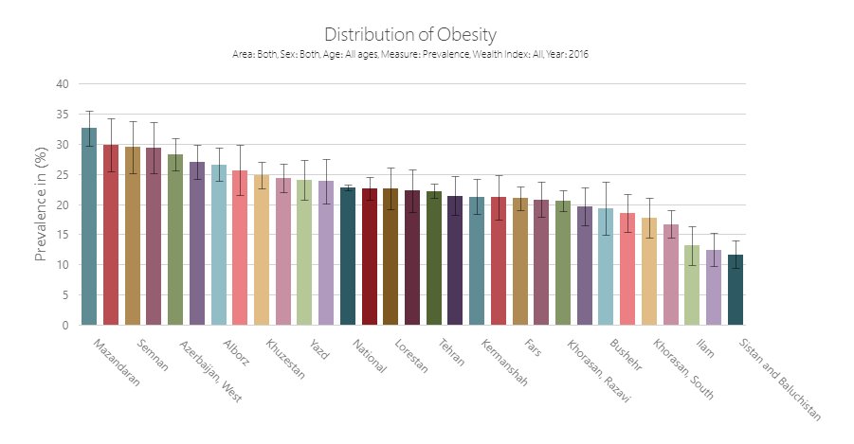

Slide 13
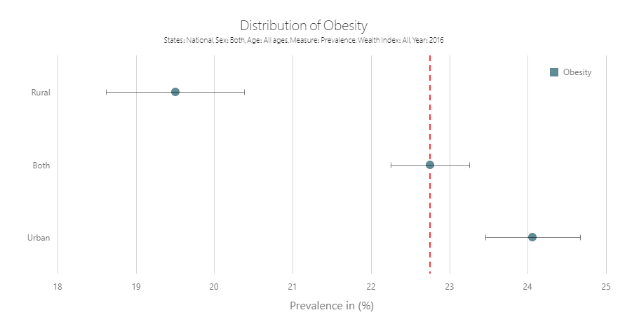

Slide 15
Women
Men
Trends of BMI and Waist Circumference (WC) levels among Iranian women and men with (red dotted line) and without diabetes (black dashed line) through 2007–2016.

Slide 16
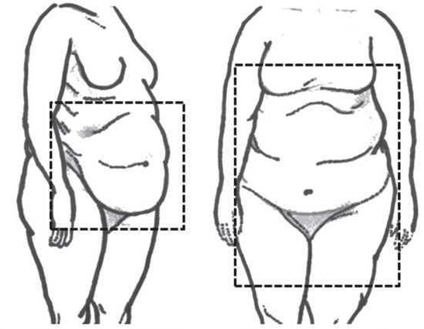
Particularly increased central obesity strongly and independently predict an increased risk of cardiometabolic diseases.
Waist circumference (WC) cut-off points of 94 and 80 Cm to define overweight BMI (25 kg/m2) and 102 and 88 Cm for obese BMI (30 kg/m2) for men and women, respectively, have been recommended.

Slide 18
https://www.worldometers.info/coronavirus/

Slide 22
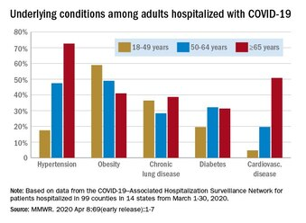
Although only ~25% of all patients infected with SARS- CoV-2 have comorbidities, 60–90% of hospitalized patients with COVID-19 have comorbidities.

Slide 23
Obesity and COVID-19:
The Two Sides of the Coin
European Association for the Study of Obesity (EASO):
Obesity as a Risk Factor for COVID-19
COVID-19 as a Barrier to Obesity Treatment
Dicker, et al. "Obesity and COVID-19: the two sides of the coin." Obesity Facts 13.4 (2020): 430-438.

Slide 24
Two pandemics of COVID-19 and obesity are on a collision course.
World Obesity (International Association for the Study of Obesity and the International Obesity Task Force):
Obesity face a higher risk for adverse outcomes of COVID-19
Home quarantining measures have also exacerbated factors that predispose to obesity
https://www.worldobesity.org/news/new-scope-module-on-obesity-and-covid-19

Slide 25
Pulmonary and extrapulmonary pathologies of COVID-19 and cardiometabolically relevant complications in patients with obesity.
The cardiometabolic complications
that can occur in patients with COVID-19 are highlighted in darker grey.
Obesity and impaired metabolic health are both accelerators and consequences of severe COVID-19.

Slide 26
Selected estimated and adjusted hazard ratios for risk factors for COVID-19 death in OpenSAFELY
OpenSAFELY,
A new data analytics platform created to address urgent questions relating to the epidemiology and treatment of coronavirus disease 2019 (COVID-19) in England.
Global pandemics interconnected—obesity, impaired metabolic health and COVID-19. Nature Reviews Endocrinology. 2021 Jan 21:1-5.

Slide 27
Particularly increased central obesity strongly and independently predict an increased risk of cardiometabolic diseases.

Slide 28
Distribution of different weight and fat measures.
Each 10 cm2 increase in visceral adipose area measured by CT was associated with an OR of 1.37 (95% CI 1.07–1.89) for ICU Treatment.
"The role of visceral adiposity in the severity of COVID-19: highlights from a unicenter cross-sectional pilot study in Germany." Metabolism 110 (2020)

Slide 29
Selected causes, consequences and treatment of severe COVID-19

Slide 30


