Slide 2
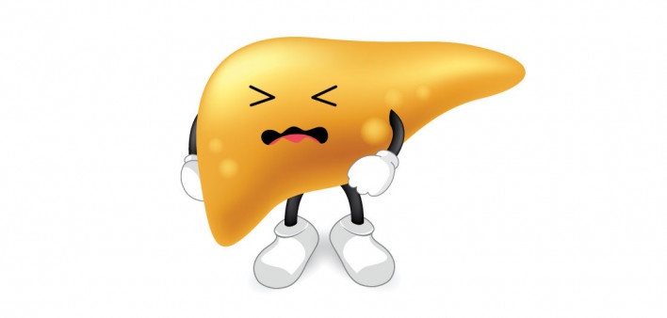
تغذیه درمانی در کبد چرب
دکتر مهدیه گل زرند
استادیار مرکز تحقیقات تغذیه در بیماری های غدد درون ریز
دانشگاه علوم پزشکی شهیدبهشتی

Slide 3
Definitions of NAFLD, NAFL and NASH
NAFLD
Excessive hepatic fat accumulation with IR
Steatosis in >5% of hepatocytes
Exclusion of secondary causes and AFLD
NAFL
Pure steatosis
Steatosis and mild lobular inflammation
NASH
HCC
Early
F0/F1 fibrosis
Fibrotic
≥F2 to ≥F3 fibrosis
Cirrhotic
F4 fibrosis
Definitive diagnosis of NASH requires a liver biopsy

Slide 4
Spectrum of NAFLD and concurrent disease
Sub-classification of NAFLD | Most common concurrent diseases
NAFL Pure steatosis Steatosis and mild lobular inflammation | AFLD† Drug-induced fatty liver disease HCV-associated fatty liver disease Others Haemochromatosis Autoimmune hepatitis Coeliac disease Wilson disease A/hypo-betalipoproteinaemia lipoatrophy Hypopituitarism, hypothyroidism Starvation, parenteral nutrition Inborn errors of metabolism Wolman disease (lysosomal acid lipase deficiency)
NASH Early NASH (no or mild fibrosis) Fibrotic NASH (significant/advanced fibrosis) NASH cirrhosis
HCC
*Also called primary NAFLD and associated with metabolic risk factors/components of MetS: 1. Waist circumference ≥94/≥80 cm for Europid men/women; 2. Arterial pressure ≥130/85 mmHg or treated for hypertension; 3. Fasting glucose ≥100 mg/dl (5.6 mmol/L) or treated for T2DM; 4. Serum triacylglycerols >150 mg/dl (>1.7 mmol/L); 5. HDL cholesterol <40/50 mg/dl for men/women (<1.0/<1.3 mmol/L); †Also called secondary NAFLD. Note that primary and secondary NAFLD may coexist in individual patients. Also NAFLD and AFLD may coexist in subjects with metabolic risk factors and drinking habits above safe limits; ‡Can occur in the absence of cirrhosis and histological evidence of NASH, but with metabolic risk factors suggestive of ‘‘burned-out” NASH
EASL–EASD–EASO CPG NAFLD. J Hepatol 2016;64:1388–402

Slide 6
NAFLD 25% (3-7% NASH / 1-2% cirrhosis) of general population
NAFLD 7% of normal-weight
MetS and its components increase the risk of NAFLD
HCC is the 4 causes of cancer death worldwide
Annually 0.5% to 2.6% among patients with NASH cirrhosis

Slide 8
Pathogenesis: lifestyle and genes

Slide 9
Unhealthy lifestyles including:
1- High calorie intake
2- Excess (saturated) fat
3- High fructose intake
4- Sedentary behaviour
Unhealthy lifestyles development and progression of NAFLD

Slide 10
Genes:
1- PNPLA3 I148M
2- TM6SF2 E167K
Associated with risk of NASH
Genotyping is not recommended routinely

Slide 11
Other risk factors
Obesity especially abdominal obesity
Type 2 diabetes
Hypertension
Hyperlipidemia
Metabolic syndrome
Older people > 50 years
smoking

Slide 12
Diagnosis: protocol for evaluation of NAFLD

Slide 13
Usually asymptomatic; majority discovered by chance
Fatigue frequently present
Right upper quadrant discomfort
Abnormal LFTs
Patients with IR and/or metabolic risk factors (i.e. obesity or MetS) should undergo procedures for the diagnosis of NAFLD

Slide 14
Level | Variable
Initial evaluation | Alcohol intake: <20 g/day (women), <30 g/day (men) Personal and family history of diabetes, hypertension and CVD BMI, waist circumference, change in body weight Hepatitis B/hepatitis C virus infection History of steatosis-associated drugs Liver enzymes (ALT, AST, GGT) Fasting blood glucose, HbA1c, OGTT, (fasting insulin [HOMA-IR]) Complete blood count Serum total and HDL cholesterol, triacylglycerol, uric acid Ultrasonography (if suspected for raised liver enzymes)
Extended* evaluation | Ferritin and transferrin saturation Tests for coeliac and thyroid diseases, polycystic ovary syndrome Tests for rare liver diseases (Wilson, autoimmune disease, AATD)

Slide 15
Enzymes patterns in liver diseases
Hepatocellular diseases | AST, ALT, LDH
Cholestasis disease | ALP, GGT, Bili (D), 5NT
Liver dysfunction | Albumin, Bili, INR profile

Slide 16
ALT / AST not sensitive tool for diagnosis NAFLD/NASH: Ultrasound essential
Ultrasound:
Identify steatosis
Cannot distinguish type of NAFLD
To establish the degree of inflammation and fibrosis non-invasive tools is warranted

Slide 17
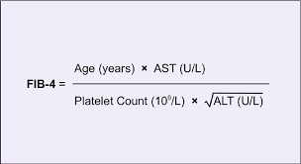
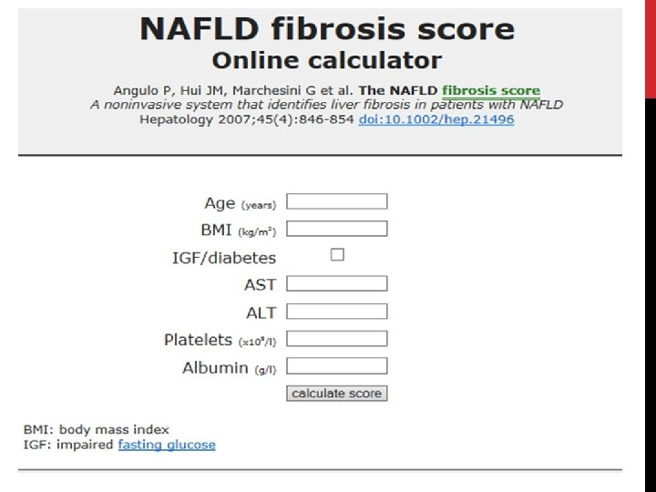
Non-invasive tools:
1- Hepatic fibrosis markers: Fibrosis Score (NFS) and Fibrosis 4 (FIB-4)

Slide 18
2- Imaging including: Fibroscan
Advantage:
High performance for Fibrosis and cirrhosis
Limitations:
Morbid obesity
Ascites
Extra-hepatic cholestasis
Pregnancy

Slide 19
Liver Biopsy: Gold Standard for fibrosis
Sampling errors
Expensive
Need hospitalization
Dependent of observers interpretation

Slide 21
Treatment: diet and lifestyle changes

Slide 22
Recommendations
Healthy diet and habitual physical activity
No pharmacotherapy

Slide 24
Results of a meta-analysis:
WL ≥ 5% hepatic steatosis
WL ≥ 7% improvement in the NAFLD Activity Score (NAS)
Results of a recent study: WL > 10%
45% regression of fibrosis
90% resolution of steatohepatitis
100% improvements in NAS

Slide 25
Weight loss
EASL 2016: 7%-10% total WL
AASLD 2018: ≥5% for steatosis improvement, ≥7% for histological improvement
ESPEN 2019: 7%-10% in overweight/obese patients, >10% to improve fibrosis
APASL 2020: 7%-10% total WL
Weight reduction not exceed approximately 1.6 kg/week

Slide 26
Energy restriction
EASL 2016: 500-1000 kcal/day
AASLD 2018: 750-1000 kcal/day
ESPEN 2019: Hypocaloric diet
APASL 2020: 500-1000 kcal/day

Slide 27
High protein diet decrease intrahepatic lipid content
animal protein or plant protein???
Animal proteins increase Met, Hcy and Cys
Plant proteins increase BCAAs
Controversy ???

Slide 28
Low carbohydrate diet (LCD): reduction in intrahepatic lipid content
Hypocaloric LCD is more effective than hypocaloric LFD
VLCD contains 5-10% carbohydrate: very effective in short-term
Intermittent calorie restriction: reduced LFTs but long-term feasibility and safety is controversial

Slide 29
Macronutrient composition
EASL 2016: low-carbohydrate ketogenic diets or high-protein
AASLD 2018: NS
ESPEN 2019: Mediterranean diet
APASL 2020: low-carbohydrate, low-fat and Mediterranean-type diets

Slide 30
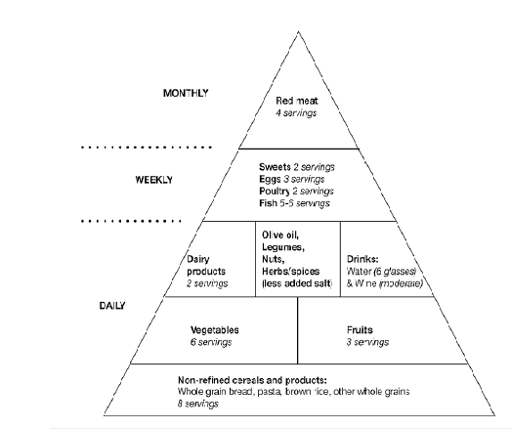
The Mediterranean diet
Fruit and vegetables
Whole grains
Nuts and legumes
Fish and olive oil
Reduces hepatosteatosis and liver stiffness measurement (LSM)
Reduced risk of HCC or liver-related death

Slide 31
Processed food and Fructose
EASL 2016: Avoid processed foods and fructose-containing beverage and foods
AASLD 2018: NS
ESPEN 2019: NS
APASL 2020: Exclusion of processed foods and beverages high in added fructose

Slide 32
SSB higher NAFLD prevalence, NASH presence and fibrosis
Fructose- but not glucose-SSB have been associated with:
increased de novo lipogenesis
dyslipidemia
visceral adiposity
impaired insulin sensitivity

Slide 33
Alcohol
EASL 2016: <30 g for men and 20 g for women
AASLD 2018: Not consume heavy amounts of alcohol
ESPEN 2019: Abstain
APASL 2020: Lower than “threshold levels” in MAFLD should be set

Slide 34
Coffee
EASL 2016: No limitations
AASLD 2018: NS
ESPEN 2019: Benefit health more than harm
APASL 2020: NS

Slide 35
Results of meta-analyses:
coffee consumption leads to:
A 29% lower risk of NAFLD
A 30%-39% lower risk of liver fibrosis
A 39% lower risk of cirrhosis

Slide 36
Exercise
EASL 2016: 150-200 min/wk of moderate intensity aerobic PA (3-5 sessions) and resistance training is also effective
AASLD 2018: > 150 min/wk moderate intensity PA
ESPEN 2019: Increase physical activity
APASL 2020: Aerobic exercise and resistance training

Slide 37
Treatment: pharmacotherapy

Slide 38
Treatment should be indicated in:
Progressive NASH
Early-stage NASH with risk of fibrosis progression*
Active NASH with high necroinflammatory activity
No drugs are approved for NASH
No specific therapy can be recommended
Any drug treatment is off label

Slide 39
Pioglitazone (PPARγ agonist)
Improved all histological features except fibrosis
Achieved resolution of NASH more often
Vitamin E (800 IU/d)
Improve steatosis, inflammation and ballooning
Resolve NASH in some patients
Concerns about long-term safety exist
The optimal duration of therapy is unknown up 6 months

Slide 40
Two new drugs:
1- Sodium glucose co-transporter 2 (SGLT2) inhibitor
Dapagliflozin
Empagliflozin
2- GLP-1 analogue
Liraglutide

Slide 41
Herbal medicine

Slide 42
Synbiotics and probiotics: lack of data about histologic benefits
Statins: no benefits or harm to liver disease
Metformin: Little evidence
n-3 PUFA: no data to support their use specifically for NASH
Nutritional supplements

Slide 43
Treatment: pediatric NAFLD

Slide 44
Diet and physical activity improve steatosis and hepatic inflammation in pediatric NAFLD
No beneficial effects on fibrosis
No safe drug treatment has proven effective on fibrosis in pediatric NAFLD

Slide 45
Treatment: surgery

Slide 46
Bariatric surgery:
Reduces liver fat and is likely to reduce NASH progression
Prospective data have shown an improvement in all histological lesions of NASH, including fibrosis
A meta-analysis of 32 studies:
Resolution of steatosis in 66%
Fibrosis in 40% of patients
Worsened in 12% of these patients

Slide 47
Liver transplantation:
An accepted procedure in patients with NASH and end-stage liver disease. Overall survival is comparable to other indications, despite a higher cardiovascular mortality.
Only for patients with NASH and liver failure and/or HCC

