Slide 1
Cardiometabolic Aspects of PCOS
F. Hosseinpanah, M.D
Obesity Research Center
Research Institute for Endocrine sciences
Shahid Beheshti University of Medical Sciences
October 21, 2021

Slide 2
Points to address in this lecture:
Is there any association between PCOS and metabolic abnormalities?
Is there any causal relationship between PCOS and development of cardiovascular outcomes ?

Slide 3
Characteristics of PCOS
Chronic anovulation
Hyperandrogenemia
Metabolic abnormalities

Slide 4
IR and PCOS
Studies with the euglycaemic clamp technique indicate that insulin resistance is a common feature of the syndrome, and both obese and non obese women with the syndrome are more insulin-resistant and hyperinsulinaemic than age- and weight-matched normal women
Chang et al 1983; Dunaif et al 1989, 1992

Slide 5
Obese PCOS women had signiﬁcantly decreased insulin sensitivity compared with
nonobese PCOS women (Dunaif, 1995)

Slide 6
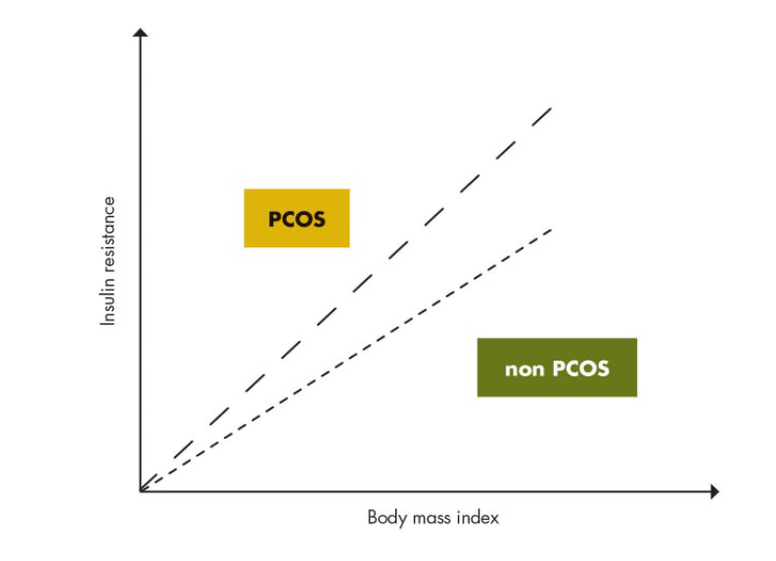
With increasing BMI, women with PCOS, compared with BMI-matched non-PCOS women, appear to accrue more insulin insensitivity
Modified from N. Sattar: Polycystic ovary syndrome. The metabolic syndrome, 2nd
ed. (edited by C. D. Byrne and S. H. Wild), Wiley-Blackwell, Oxford, UK, 2011

Slide 7
Overall IS was lower in women with PCOS compared with controls (mean effect −27%, 99% CI ±6%; large, most likely lower)
A higher BMI exacerbated the reduction in IS by −15% (±8%; moderate, most likely lower) in PCOS compared with control women.
There was no clear difference in IS between women diagnosed by the original National Institutes of Health (NIH) criteria alone compared with those diagnosed by the Rotterdam criteria.
Low levels of sex hormone binding globulin (SHBG) were associated with reduced levels of IS (−10%, ±10%; small, very likely negative), which was not confounded by BMI
Hum Reprod 2016; 31:2619–2631

Slide 8
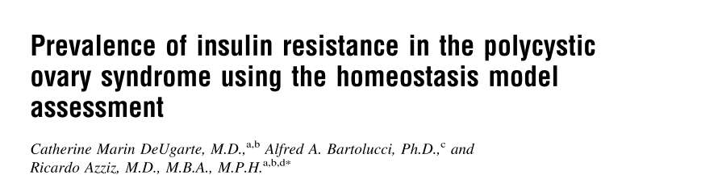
Objective: To determine the prevalence of insulin resistance (IR) in a large population of patients with the polycystic ovary syndrome (PCOS)
Design: Prospective, case-control
Setting: University medical center
Fertility and Sterility, Vol. 83, No. 5, May 2005

Slide 9
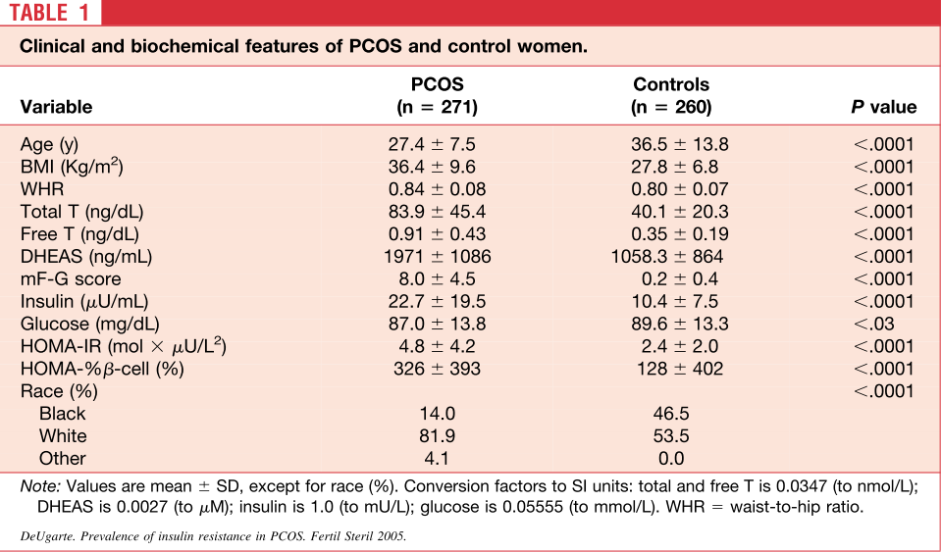
After adjustment, 64.4% of PCOS patients were noted to be insulin resistant, and 2.6% had β-cell dysfunction

Slide 10
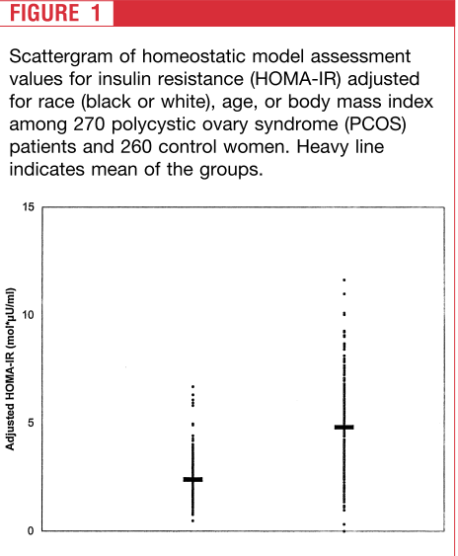
Control PCOS

Slide 11
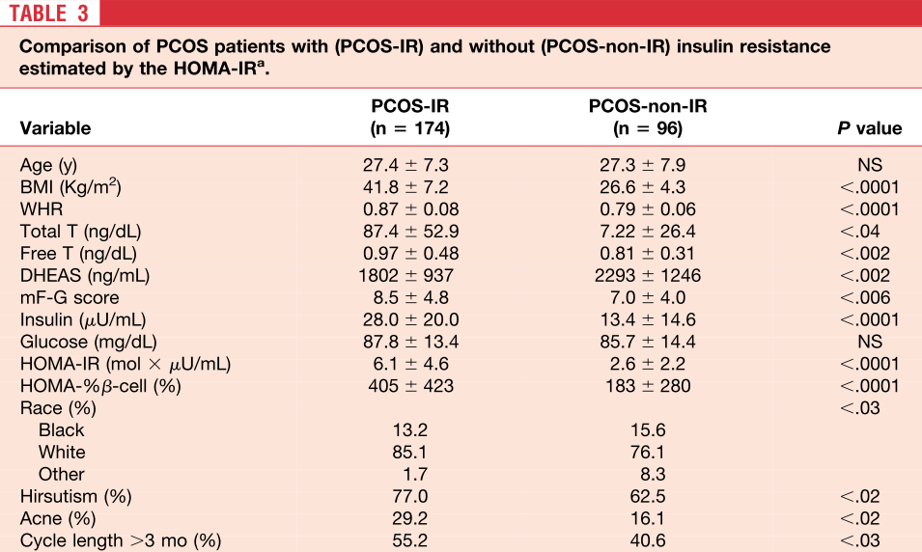

Slide 12
Key messages
In patients with PCOS, the prevalence of IR was 64% according to the HOMA-IR measurement, after adjustment
Patients with IR were more clinically affected
Although IR is a common abnormality in PCOS, it does not seem to be a universal feature

Slide 13
Underlying Pathway
Intrinsic insulin resistance leads to increased lipolysis from adipose tissue and facilitates dyslipidemia, which has a toxic effect on the pancreatic islet cells . As a result, apoptosis of pancreatic islet cells is induced, increasing the risk for glucose intolerance and eventually chronic hyperglycemia and T2D
Insulin resistance is also linked to hypertension through the impairment of the insulin specific endothelial pathway, resulting in vasoconstriction through a diminished nitrogen oxide production
Finally, hyperinsulinemia leads to vascular inflammation and water retention in the kidney which contributes to an elevated blood pressure
Dyslipidemia and elevated blood pressure are important factors in aggravating the process of atherosclerosis eventually leading to cardiovascular events

Slide 14
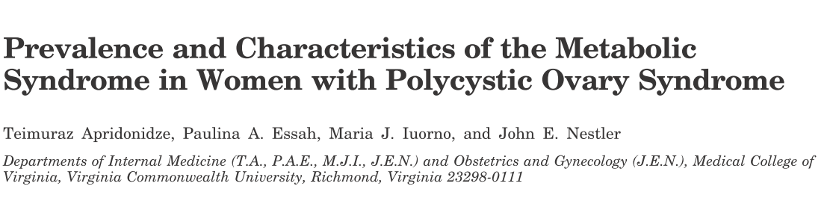
Retrospective medical chart review of women with PCOS
seen in an Endocrine Clinic
NCEP ATP III criteria was used for definition of Mets
Of the 161 PCOS cases reviewed, 106 met the inclusion criteria.
The women were divided into two groups: 1) women with
PCOS and the Mets (n =46); and 2) women with PCOS lacking the Mets(n =60)
Apridonidze T et al, JCEM 2005;90:1929-35

Slide 15
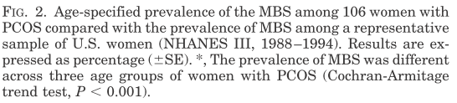
53
45
21
15
6
Overall prevalence of MS was 43% (2-fold higher than in the general population)
.

Slide 16
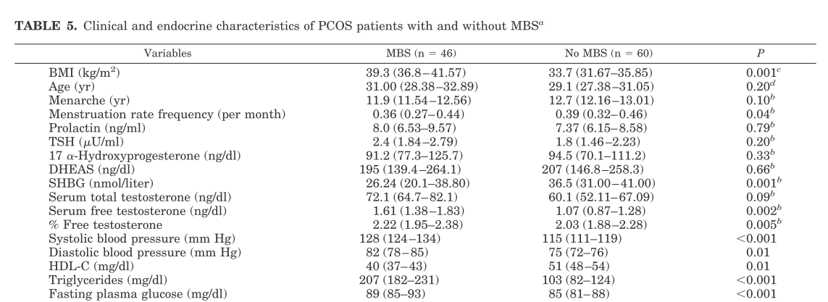

Slide 17
Key messages
Mets and its components are common in women with PCOS, placing them at increased risk for cardiovascular disease
Women with PCOS and the Mets differ from their counterparts lacking the Mets in terms of increased hyperandrogenemia, lower serum SHBG, and higher prevalence of acanthosis nigricans, all features that may reflect more severe insulin resistance

Slide 18
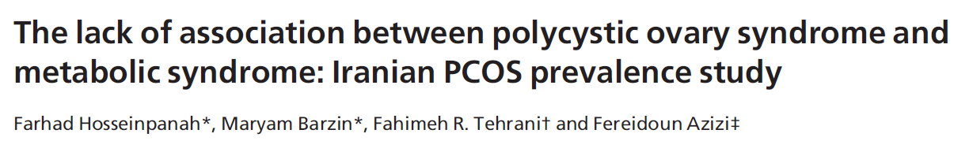
Objective: To evaluate the prevalence of the metabolic syndrome and insulin resistance in a large population-based study in Iran
One hundred and thirty six PCOS subjects and 423 healthy controls recruited from among 1126 reproductive aged women (18–45 year) were compared
Clinical Endocrinology (2011) 75, 692–697

Slide 19
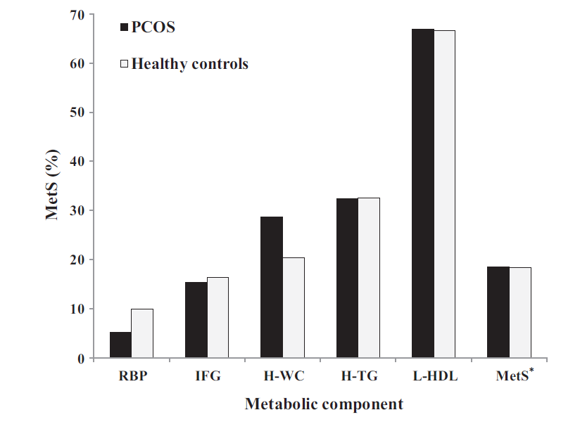
Metabolic syndrome was no more frequent in a representative sample of PCOS Iranian population than in healthy controls
.
18.5% Vs 18.3%

Slide 20
Important message
Method of recruitment of PCOS women and controls can seriously influence the estimates of metabolic abnormalities

Slide 21
Impaired glucose tolerance, type 2 diabetes and metabolic syndrome in polycystic ovary syndrome: a systematic review and meta-analysis
Hum Reprod Update 2010;16:347–63

Slide 22
Surrogate outcomes for cardiovascular disease in women with PCOS versus controls
Clin Endocrinol (Oxf) 2013;78:438–46
Hum Reprod Update2012;18:112–26
J Clin Endocrinol Metab 2004;89:5454–61
J Clin Endocrinol Metab 2007;92:4609–14
Vasc Health Risk Manag 2008;4:453–62

Slide 23
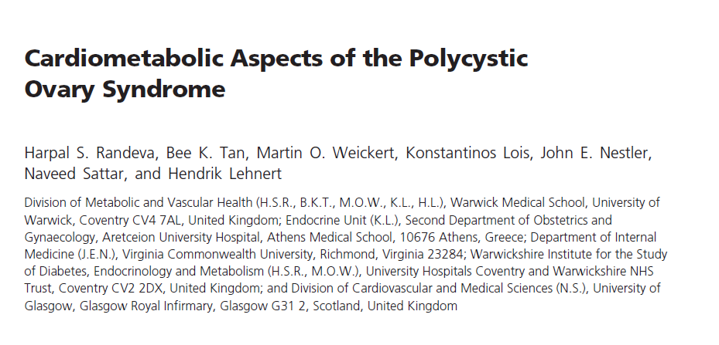
Endocr Rev.2012 Oct;33(5):812-41

Slide 24
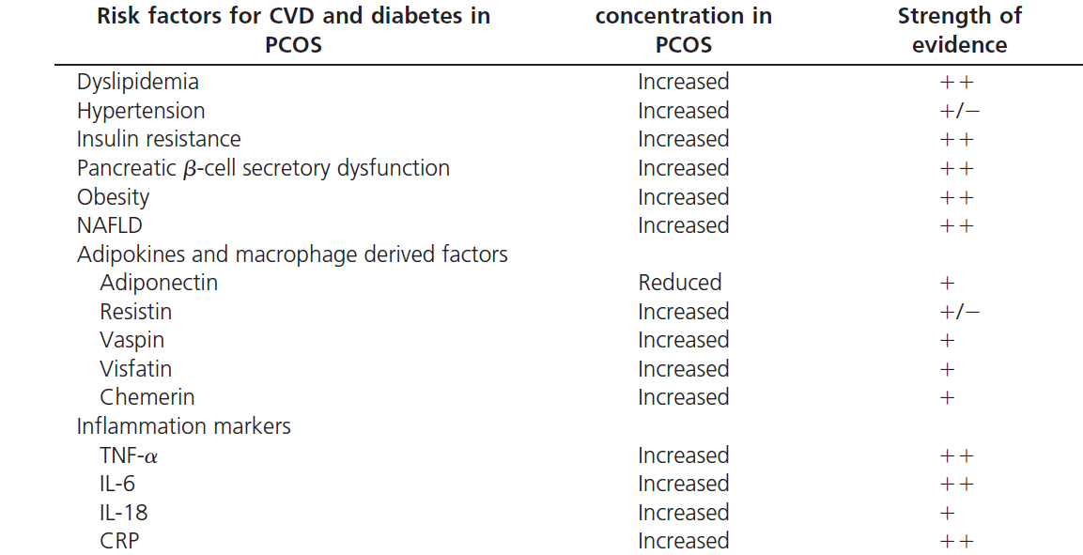
Incidence of well-established and novel risk factors for CVD and diabetes in PCOS

Slide 25

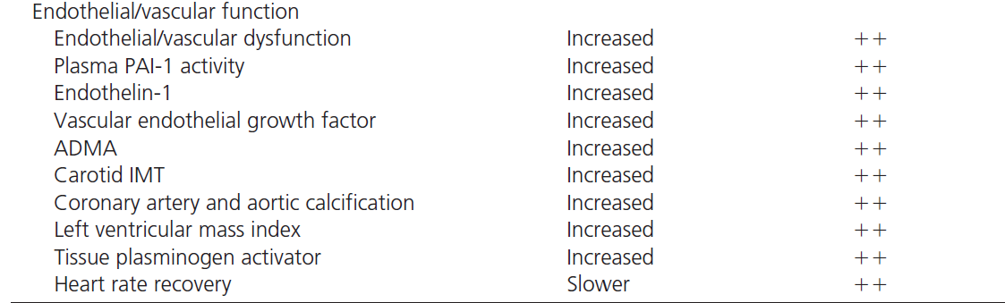
Continued..

Slide 26
Polycystic ovary syndrome is a risk factor for diabetes and prediabetes in middle-aged but not elderly women: a long-term population-based follow-up study
Objective: To study the incidence rate and hazard ratios of diabetes and prediabetes between women with PCOS and healthy subjects.
Patient(s): Women with PCOS (n = 178) and eumenorrheic, non hirsute, healthy women as controls (n = 1,524), all followed for a median time of 12.9 years.
Main Outcome Measure(s): Incidence rate and hazard ratios of diabetes and prediabetes between women with PCOS and healthy controls
Kazemi et al,Fertil Steril. 2017 Dec;108(6):1078-1084

Slide 27
The risk of developing diabetes and prediabetes in young women with PCOS is 4.9 and 1.7 times higher, respectively, than in the general population. However, those hazard differences between PCOS and controls disappeared in their late reproductive years

Slide 28
This study was conducted on 637 participants (85 PCOS and 552 control reproductive aged, 18–45 years) of TLGS, an ongoing population based cohort study with 12 years of follow-up.
PLoS One. 2015 Sep 11;10(9):e0137609

Slide 29
The negative interaction (follow-up
years × PCOS status) of PCOS and normal women converged overtime

Slide 30
Key messages
While the insulin level and insulin resistance rate were higher in reproductive aged PCOS than in healthy women, the difference of these risk factors decreased overtime.
Thus, the metabolic consequences of PCOS women in later life may be lower than those initially anticipated
PLoS One. 2015 Sep 11;10(9):e0137609

Slide 31
PCOS and CVD
  While there is a large body of literature finding increased CVD risk factor burden in PCOS (e.g., dyslipidemia, hypertension), as well as subclinical atherosclerosis (e.g., increased carotid intima-media thickness, increased coronary artery calcium), whether this translates into increased CVD events is uncertain

Slide 32
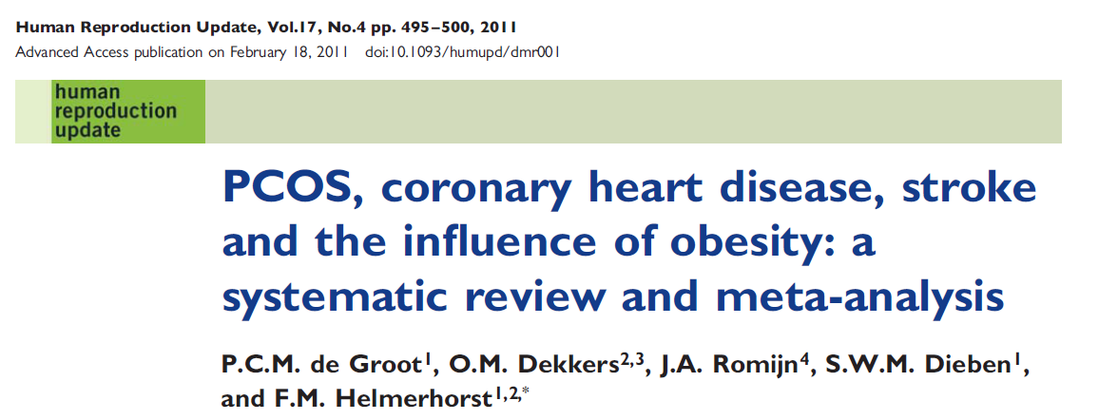

Slide 33
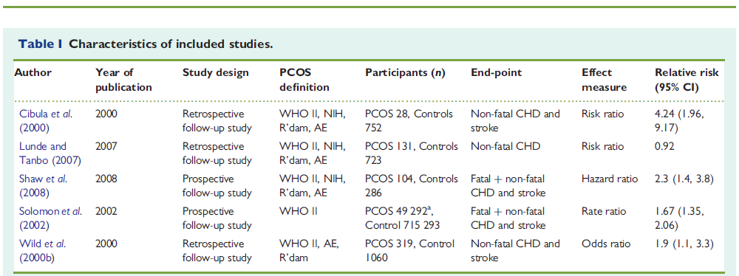

Slide 34
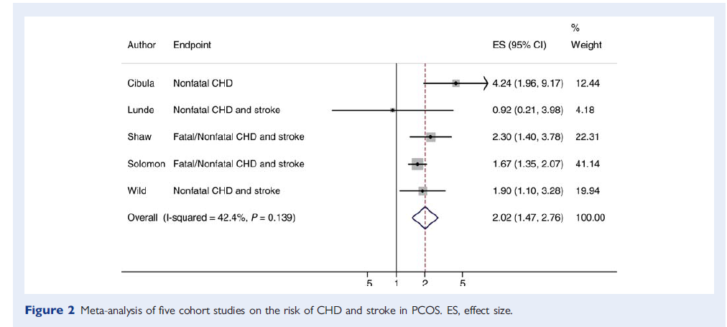

Slide 35
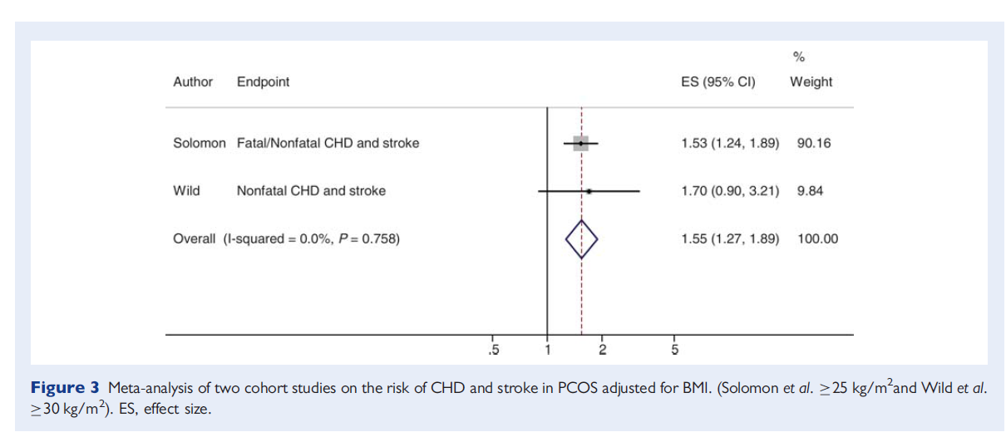

Slide 36
Key messages
A significant 2-fold risk of CHD and stroke for patients with PCOS relative to women without PCOS was found, 2.2(95% CI 1.46-2.76)
Risk was still increased by 55% in the studies that adjusted for BMI, 1.55(95%CI 1.27-1.89)
It means that increased BMI is not the sole cause of the increased cardiovascular risk in women with PCOS

Slide 37
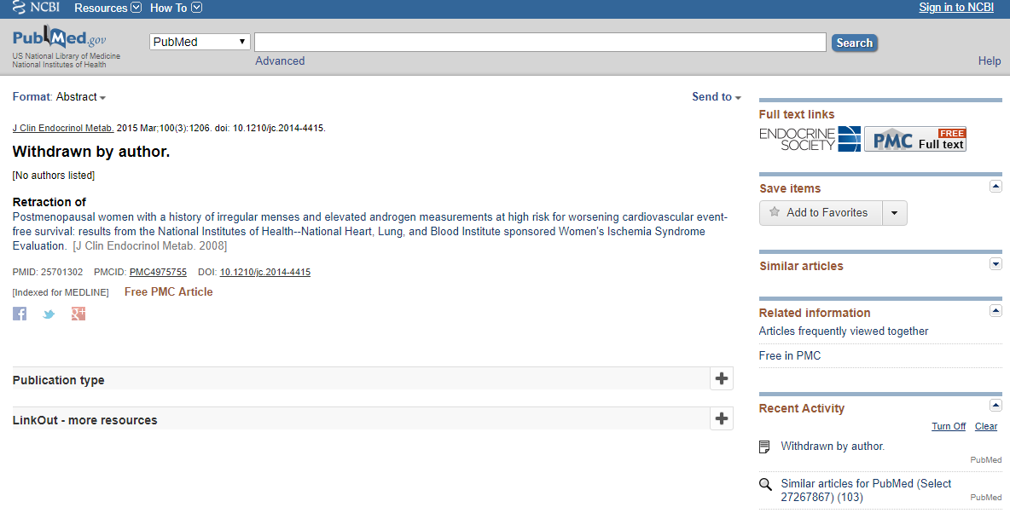

Slide 38
This study aimed to evaluate the prevalence (P)/hazard ratio (HR) of cardiovascular (CV) events among reproductive age and menopausal age women with polycystic ovary syndrome (PCOS) in comparison with healthy controls
The primary outcomes were a composite outcome of CV events [including coronary arterial disease (CAD), cardiovascular disease (CVD), myocardial infarction (MI), angina, heart failure, and ischemic heart disease] and mortality due to CV events
Sixteen studies including 12 population-based were analyzed for the meta-analysis
Gynecol Endocrinol2020 Jan;36(1):12-23

Slide 39
. 2020 Jan;36(1):12-23
Forest plot of pooled hazard ratio of cardiovascular events for all included studies

Slide 40
Forest plot of pooled hazard ratio of cardiovascular events for population based studies.

Slide 41
Forest plot of pooled hazard ratio of mortality due to cardiovascular events

Slide 42
Key messages
Mainly based on population-based study, we found a greater risk of CV events in reproductive aged but not in menopausal/aging PCOS women, suggesting that having a history of PCOS during reproductive ages may not be an important risk factor for developing events in later life

Slide 43
We searched from inception to September 2019 in MEDLINE and EMBASE using controlled terms (e.g. MESH)
and text words for PCOS and cardiometabolic outcomes, including cardiovascular disease (CVD), stroke, MI , hypertension (HT), type 2 diabetes (T2D), metabolic syndrome and dyslipidemia
23 cohort studies were included in the current systematic review
Human Reproduction Update, Vol.26, No.6, pp. 942–960, 2020

Slide 45
Forest plot for hypertension (HT)
Forest plot for hypertension (HT)

Slide 46
Forest plot for Type 2 DM

Slide 51
Forest plots for non-fatal coronary events

Slide 52
Forest plots for non-fatal cerebrovascular events

Slide 53
Forest plot for composite outcome for non-fatal cardiovascular disease events

Slide 54
Forest plot for composite outcome for fatal cardiovascular disease events

Slide 55
Key messages
Women with PCOS had a substantially increased crude risk for future HT and T2D. Also, PCOS might lead to adverse lipid serum concentrations and increase in non-fatal cerebrovascular events, although sensitivity meta-analyses including only high-quality studies did not indicate these associations.
We were unable to establish point estimates that accounts for excess obesity rates among women with PCOS.
Whether screening strategies can amend this cardiometabolic risk should be investigated

Slide 56
A two-sample Mendelian randomization study to investigate the associations of PCOS with type 2 diabetes, coronary heart disease (CHD), and stroke
Association between PCOS and diabetes risk was examined in European and Asian cohorts, both sex specific and sex combined
Causal effects of PCOS on risks of CHD and stroke were evaluated in European cohorts
Stroke was analyzed as any stroke as well as four subtypes of stroke (ischemic, large artery, cardioembolic, small vessel)
Diabetes.2021 Feb;70(2):627-637

Slide 62
Key messages
According to primary MR analyses by the IVW method, genetically predicted PCOS is not significantly associated with the risk of diabetes, CHD, or any stroke traits
This suggests that PCOS in and of itself does not increase the risk of these outcomes
Other features of PCOS (obesity, elevated testosterone, low sex hormone binding globulin) may explain the association between PCOS and cardiometabolic diseases
In light of these results, efforts to prevent cardiometabolic complications in PCOS should focus on women with high-risk features rather than all women with PCOS

Slide 63
How can we explain the paradox?
Inadequate PCOS characterization
Cardiovascular risk profiles may vary with PCOS phenotype, age, ethnicity and BMI
Inadequate CV disease measurement
Insufficient duration of follow-up
Progressive normalization of some CV risk factors in late reproductive years
Possible cardio-protective effect of this reproductive longevity
Better risk factor management compared to non PCOS women
……..

Slide 64
Screening A. Criteria for disease/condition
1. Relatively common
2. Seriously disabling
3. Recognized identifiable preclinical phase
4. Natural history of condition should be understood

Slide 65
Screening
A. Criteria for disease/condition
5. Treatment of preclinical disease more effective than treatment begun after symptom development
6. Recognized treatment available
7. Facilities for treatment
8. Treatment acceptable to population

Slide 66
Cardiovascular risk factors
We recommend that adolescents and women with PCOS be screened for the following cardiovascular disease risk factors :
Family history of early cardiovascular disease,
Cigarette smoking,
IGT/T2DM, hypertension,
Dyslipidemia
OSA
Obesity (especially increased abdominal adiposity)
An Endocrine Society Clinical Practice
Guideline, J Clin Endocrinol Metab 98: 4565–4592, 2013

Slide 67
Obesity
Increased adiposity, particularly abdominal, is associated with hyperandrogenemia and increased metabolic risk
Therefore, we recommend screening adolescents and women with PCOS for increased adiposity, by BMI calculation and measurement of waist circumference.
An Endocrine Society Clinical Practice
Guideline, J Clin Endocrinol Metab 98: 4565–4592, 2013

Slide 68
Type 2 diabetes mellitus
We recommend the use of an OGTT (consisting of a fasting and 2-hour glucose level using a 75-g oral glucose load) to screen for impaired glucose tolerance (IGT) and T2DM in adolescents and adult women with PCOS because they are at high risk for such abnormalities .
HgbA1c test may be considered if a patient is unable or unwilling to complete an OGTT
Rescreening is suggested every 3–5 years, or more frequently if clinical factors such as central adiposity, substantial weight gain, and/or symptoms of diabetes develop
An Endocrine Society Clinical Practice
Guideline, J Clin Endocrinol Metab 98: 4565–4592, 2013

Slide 69
Hum Reprod. 2018 Sep 1;33(9):1602-1618.

Slide 71
Conclusions
In spite of a large body of evidence indicating association of cardiometabolic risk factor and PCOS; however, whether the relationship is causal is uncertain
More importantly , it is not evident whether presence of cardiometabolic risk factor in reproductive years among women with PCOS translates into cardiovascular events in later life
  It is important to note that establishing a relationship between abnormal biochemical markers at a young age and CV disease decades later is not an easy task
large, prospective cohort studies with well-phenotyped women with PCOS and standardized long-term follow-up is needed

Slide 72
Conclusions
  The ongoing controversy around the increased occurrence of CV events in PCOS despite the presence of many risk factors at a young age raises some debates on screening of PCOS women for metabolic and cardiovascular risk factors
  A randomized trial comparing screening of established cardiometabolic risk factors, such as HT, T2D and dyslipidemia in women with PCOS to no screening, in combination with long-term follow-up to evaluate the effect of treatment on cardiometabolic outcomes (blood pressure, glucose metabolism and lipids) and event rates (fatal and non-fatal coronary or cerebrovascular events) to usual care, would provide the best answer as to whether screening is effective

