Slide 1
Perioperative management of pituitary surgery
Mahtab Niroomand M.D.
Associated professore of Endocrinology
SBMU
2/10/1400

Slide 2
Outlines:
Preoperative management of pituitary tumors
Indication of preoperative of GC replacement before surgery
Complications of pituitary surgery
Postoperative management of pituitary surgery (Diagnosis and Treatment)
  Sodium and water disturbance
  HPA axis insufficiency

Slide 3
Introduction
Pituitary lesions are common in the general population
Approximately 15 to 20% of individuals having evidence of an identifiable lesion on brain imaging.
Pituitary tumors are the second most common brain pathology
Due to the anatomic location of suprasellar and pituitary tumours, interventional brain surgery can have peri and postoperative complications related to anterior and posterior pituitary dysfunctions with fluid and electrolyte disorders.
Scangas GA, Laws ER Jr. Pituitary incidentalomas.Pituitary. 2014;17:486-491.
Dolecek TA, Propp JM, Stroup NE, Kruchko C.CBTRUS statistical report: primary brain and central nervous system tumors diagnosed in the United States in 2005-2009. Neuro Oncol. 2012;14 Suppl 5:v1-49.

Slide 4
Preoperative management of pituitary tumors
Assessment of pituitary function:
  Anterior pituitary:
    FSH, LH, Testosterone, Estradiol (premenopausal)
    T4, T3RU, TSH,
    Seum Prolactin
    GH, IGF1
    HPAA: ACTH, ITT, SST (Cozyntropin test)
  Posterior pituitary:
    Fluid Intake, Urine Output, Serum Na, Serum and Urine osmolality
Assessment of visual dysfunction:
    Visual acuity
    Complaints of blurriness
    Double vision
    Peripheral field dysfunction
Assessment of neurological dysfunction

Slide 5
Preoperative management of pituitary tumors
The most important assessments are to determine the need for GC and thyroid hormone replacement before the patient undergoes the stress of anesthesia and surgery.
The need for other hormone replacements should be determined after resection of the pituitary lesion.

Slide 6
Preoperative Glucocorticoid replacement
Indication:
  HPAA insufficiency
  All patients?
Dose:
  Low or high dose
Duration of GC administration
Side effect:
  Impaired wound healing
  Increased infection rate

Slide 7
Preoperative Evaluation of HPA Axis
Patients undergoing TSS usually receive “stress dose” steroids whether the HPAA is deficient or preserved during TSS
Though RCT have not been performed to assess the necessity of steroid coverage.
Several studies show the changes of HPAaxis functions associated with pituitary surgery.
Until now, some clinical data revealed that there was no necessity for steroid supplementation in HPAA preserved patients during TSS

Slide 8
Preoperative Evaluation of HPA Axis
There is a lack of consensus regarding which tests are regarded as an appropriate workup of subclinical hypocortisolism, with significant clinical limitations to each.
Before pituitary surgery, in all patients with pituitary disease HPA axis function should be tested:
  ITT:
    Traditionally,” ITT” has been the gold standard test for integrity of HPA function and, in some units, is still the preferred preoperative test.
  Short ACTH 1–24 (Synacthen) test :
    Because these patients require reassessment of adrenal function post-op, most endocrinologists prefer this test as their initial pre-op test of HPA axis function in a patient with a known pituitary tumor.
  Methyrapone Test

Slide 9
Preoperative assessment of HPA axis function
In the setting of long-standing ACTH deficiency, the 250µg ACTH 1–24 test generally correlates well with the ITT.
Normal cortisol response to 250 µgACTH1–24 :
  Cutoff of >550 nm (20µg/dl), at 60 min

Slide 10
Preoperative assessment of HPA axis function
The first decision regarding the perioperative use of GC coverage, depends on the result of preoperative screening test:
  Abnormal ACTH 1–24 (Synacthen) test.
  Normal ACTH 1–24 (Synacthen) test

Slide 11
Abnormal ACTH 1–24 (Synacthen) test:
Start standard maintenance doses of GC (15–30 mg hydrocortisone daily, depending on age, sex, and body habitus) in the lead-up to surgery.
These patients should be treated peri-operatively with 48 h of supraphysiological GC therapy with rapid dose reduction.
  Suggested regimen:
    Hydrocortisone 50 mg /q 8 h on d 0, 25 mg/q8 h on d 1, and 25mg at 0800 h on d 2.
  Alternative regimen:
    Dexamethasone 4mg at induction of anesthesia, 2 mg at 0800 h on d 1, and 0.5 mg at 0800 h on d 2.

Slide 12
Normal ACTH 1–24 (Synacthen) test
If neurosurgeon is able to perform a selective adenomectomy,
no perioperative glucocorticoid coverage recommend
If selective adenomectomy is not possible and surgery is more extensive, glucocorticoid coverage for 48 h is recommended
Measuring 0800 h plasma cortisol on d 1–3 postoperatively is recommended.

Slide 14
Peri-operative cortisol levels in preoperative HPAA integrated patients
postoperative cortisol levels increased significantly compared with the preoperative one in preoperative HPAA functions preserved patients(P<0.00001).
A Meta Analysis for the Necessity of Steriods, PLOS ONE DOI:10.1371/journal.pone.0119621 March 16, 2015

Slide 15
The early postoperative diabetes insipidus morbidity in patients with peri-operative cortisol supplementation vs no cortisol supplementation
NO significantly increased postoperative AI and DI in no supplementation group than in supplementation group
A Meta Analysis for the Necessity of Steriods, PLOS ONE DOI:10.1371/journal.pone.0119621 March 16, 2015

Slide 16
Preoperative Glucocorticoid replacement
In systematic review and meta analysis:
  The serum cortisol levels were significantly increased in patients after TSS surgery.
  NO significantly increased postoperative AI and DI in no supplementation group than in supplementation group
In a word, there is indeed no necessity to receive routine cortisol replacement for patients with normal MSC levels and it may be used when the symptoms occur.

Slide 17
Preoperative Glucocorticoid replacement

Slide 18
Post operative management of pituitary tumors

Slide 19
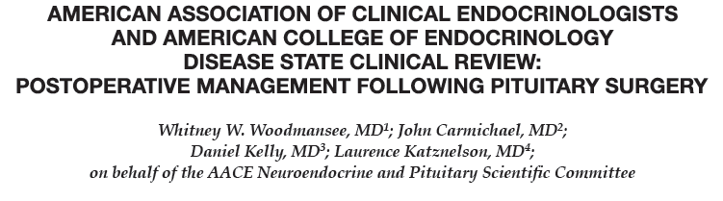

Slide 20
Post operative adverse effects:
Short term (Acute):
Long term (Chronic):
Endocrinological adverse effects:
  Sodium and water disturbance
  Hypopituitarism
Neurosurgical adverse effects:
  CSF leak
  Epistaxis
  Visual defect
  Cranial neuropathy
  Meningitis
  Intra cranial carotid artery damage
Endocrinological assessment
Neurosurgical issues

Slide 21
Postoperative Management
Postoperative management of patients undergoing pituitary tumor surgery can be considered to occur in 2 main phases:
  The early postoperative period
  The longer term outpatient follow-up period:
    The initial outpatient management
    Long-term observation

Slide 22
Early Postoperative Management
(1 to 3 days)
Major complications in the immediate postoperative period after TSS can be categorized into surgical and endocrine.
The most important potential endocrine complications in the immediate postoperative period include
  Fluid and electrolyte abnormalities
  Acute adrenal insufficiency.

Slide 23
  Fluid and electrolyte abnormalities
Disturbances in salt and water balances are relatively common after brain surgeries for suprasellar and pituitary tumours, presenting diagnostic and therapeutic challenges.

Slide 24
Fluid and electrolyte abnormalities
Hypernatraemia:
  Central diabetes insipidus (CDI)
Hyponatraemia (more diagnostic dilemma):
  SIADH
  Cerebral salt wasting (CSW)

Slide 25
Physiology of ADH release and action

Slide 26
Pathophysioloy and management of water metabolism imbalance after pituitary surgery

Slide 27
Central DI
DI which may occur in up to 25% of patients after pituitary adenoma surgery, is most frequently observed in within the first 48 hours of surgery
DI after pituitary surgery associated with 3.9-fold increase in patients’ mortality.
Patients presentation:
  Polyuria and dilute urine(urine SG typically ≤1.005)(hall mark)
  Excessive thirst (polydipsia)
Pathogenesis:
Inability to concentrate the urine due to ADH deficiency.

Slide 28
Central DI
Differential diagnosis of polyuria after pituitary surgery :
  Reactive postoperative diuresis (who received excess amounts of IV fluids during surgery)
  Hyperglycaemia
  Diuretics

Slide 29
Central DI
Polyuria is characterized by a dilute (urine osmolity<300) urine volume in excess of :
  At birth :
    2 L/m2 /24 h or approximately 150 ml/kg/24 h
  Until the age of 2 years:
    100–110 ml/kg/24 h
  Age more than 2years:
    40–50 ml/kg/24 h in an older child or adult

Slide 30
Central DI
CDI can be:
  Transient
  Permanent (approximately 2% of patients following TSS)
  Classic triphasic response (remit and then recur later postoperatively)
Classic triphasic response :
  Initially develop DI: abrupt onset within first 12–24 hours (1–3days) after surgery and lasts for 5–7 days
  Followed by transient SIADH developing 4 to 10 days postoperatively can last 2–14 days
  Followed by the return of DI in a matter of weeks.

Slide 31
Diagnostic Criteria of diabetes insipidus in the post-operative period
Increased plasma osmolality > 300 mosm/kg
Increased urine output >2.5 ml/kg/h(>250cc/h)for 2 consecutive hours
Urine osmolality <200 mosm/kg (urine SG<1005)
Urine/plasma osmolality ratio < 1

Slide 32
Measurement of copeptin
AVP measurement is rarely useful in the diagnosis of postoperative DI:
  Short half-life (16 minutes)
  Usually unstable in collected plasma samples
  Affected by many factors
Copeptin:
  C-terminal peptide of pro-vasopressin, co-secreted with AVP in an iso-osmolar manner
  Reflects AVP level accurately
  Unlike AVP, copeptin measurement is less cumbersome as it remains stable in collected plasma samples for days
  Its measurement is associated with less preanalytical errors
Copeptin is highly accurate in:
  Identifying the etiology of polyuria in the non-acute setting
Its utility in the postpituitary surgery setting has been evaluated in only a few studies.

Slide 33
Biochemical parameters in patients with postopDI
Parameter | Description
Fluid balance | Variable, usually negative (more output than input)
Urine output | At least >2 mL/kg/h for two consecutive hours in addition to other parameters
Serum osmolality | Normal, if the patient has free access to water, or high, >300 mOsmol/kg, if the patient has limited access to water
Serum sodium | Normal, if the patient has free access to water, or high, >145 mmol/L, if the patient has limited access to water
Urine osmolality | Persistently <300 mOsmol/L
Urine specific gravity | Persistently <1.005
Copeptin | <2.5 pmol/L

Slide 34
Measurement of copeptin
In the future:
  Copeptin is a promising marker that will likely be a routine diagnostic test in the evaluation of CDI.
Presently:
  Limiting its widespread use because:
    Limited number of studies about copeptin use
    Uncertainty about the optimal time of its measurement after surgery
    Limited availability of the assay are factors

Slide 35
Predictors for DI after pituitary surgery
Transient and permanent DI:
Only Transient DI :
Craniopharyngioma
Rathke’s cleft cysts
Larger tumour size
Low postoperative copeptin levels
Intraoperative CSF leak.
Permenant DI :
Younger age
Reoperation
ACTH-producing adenoma
Visual abnormalities on presentation
Supra-sellar tumour extension
Gross total resection
Postoperative CSF leak
First postoperative serum sodium of >145 mmol/L

Slide 36
Management of CDI
Rule out intraoperative fluid overload and glycosuria
Acromegaly pts. may experience increased urinary output following the resection of pituitary mass due to diuresis of excess fluid within the soft tissues.
Approximately 50% of patients (within 7 days) and 80% (within 90 days of surgery) with transient DI recover.
Monitor for the cessation of thirst sensation and resolution of polyuria as potential signs of DI recovery.
Periodic monitoring of electrolytes can be useful to confirm DI recovery
Water deprivation tests are not routinely recommended in this situation.
Delay desmopressin (DDAVP) dose for a few hours to see if increased thirst and polyuria persist.
DDAVP should be used cautiously as required, especially during the first two weeks postoperatively to avoid hyponatremia due to over replacement.

Slide 37
Management of CDI
DI can be managed with desmopressin (DDAVP)
  Subcutaneous or intravenous (0.5-2 mcg every 24 hours as needed)
  Intranasal (10 mcg metered dose) Oral formulation (often starting with 0.1-0.2 mg oral as a single dose with doses up to 0.3 mg oral 3 times daily sometimes necessary).
Many patients do not require any therapy as long as they are able to drink to thirst and their serum sodium remains within the normal range.
For others, only 1 or 2 DDAVP doses may be needed as an inpatient before the condition resolves.

Slide 38
Management of Diabetes Insipidus following Surgery for Pituitary and Suprasellar Tumours

Slide 39
SIADH
SIADH is defined by hyponatraemia and hypo-osmolality due to inappropriate ADH secretion which results in:
  Impaired water excretion despite a normal or increased plasma volume.
Between 5 and 9% of patients may also develop isolated SIADH leading to symptomatic and delayed hyponatremia.
A sodium level is often checked 5 to 8 days postoperatively, typically after the patient has been discharged from the hospital.

Slide 40
SIADH
Hyponatremia after neurosurgery:
  Usually attributed to SIADH
  Hypocortisolism and Cerebral salt wasting have also been reported.
Differentiation of SIADH from the other causes :
  Presence of a metabolic alkalosis and a high FE uric acid (usually<12%)

Slide 41
Management of SIADH
Mild hyponatremia (130-135 mmol/L) :
  Fluid restriction as an outpatient
Severe symptomatic hyponatremia(typically <125 mmol/L) :
  Hospitalization for more aggressive management including:
    Fluid restriction
    Hypertonic saline
    Administration of Vaptans, competitive antagonists of vasopressin receptors.
  Selective use of Vaptans in severe hyponatremia:
    Useful and potentially lead to shorter hospital stays.
Treatment with hypertonic saline was commenced
After discontinuing hypertonic saline at 133 mmol/L, fluid restriction increased serum sodium further to 136 mmol/L.

Slide 42
Cerebral Salt Wasting
CSW is defined by the development of extracellular volume depletion due to a renal sodium transport abnormality in patients with intracranial disease and appropriate adrenal and thyroid status
Pathophysiology : unclear
  The presence of natriuretic peptides (atrial NP and brain NP) released from the injured brain
  The loss of sympathetic stimulation to the kidney can lead to CSW
Natriuretic peptides: small polypeptides which cause natriuresis, diuresis, vasodilation, and suppression of renin, aldosterone and ADH secretion
Treatment:
  Fluid repletion with normal saline and oral salt replacement.
  In refractory cases:
    Fudrocortisone may be used with monitoring for hypokalemia, fluid overload, and hypertension

Slide 43
Clinical and biochemical differences between SIADH and CSW
 | SIADH | CSW
Body weight | Increased | Same or decreased
Plasma volume | High | Low
Evidence of volume depletion | No | Yes
Central venous pressure | Same or increased | Decreased
Plasma sodium | Low | Low
Urine sodium | High | High
Net sodium loss | Normal | High
Urine output | Usually low | Very high
Plasma osmolality | Low | Low

Slide 44
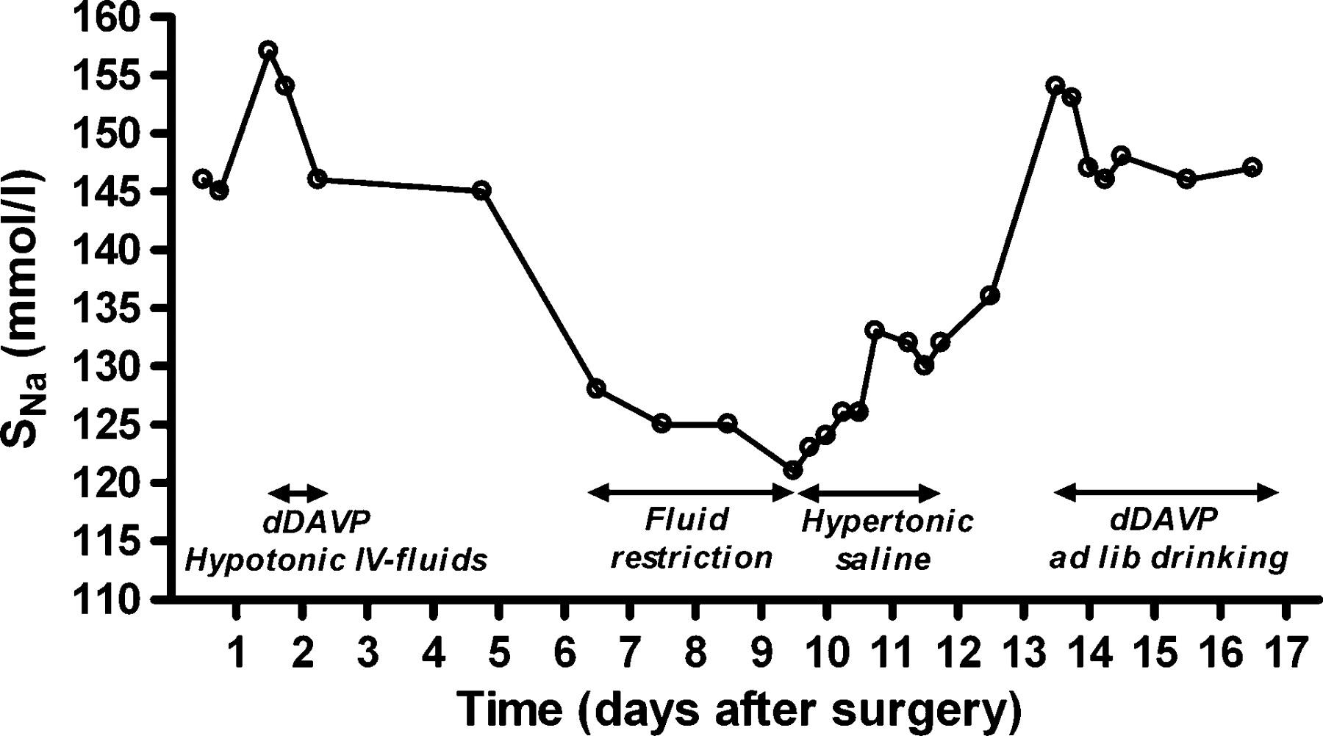
Triphasic serum sodium course after neurosurgery
Ewout J. Hoorn, and Robert Zietse NDT Plus 2010;3:42-44

Slide 45
Acute adrenal insufficiency
Who needs a definitive test of their HPA axis?
Which test should be performed?
When is the optimal time to perform the test?

Slide 46
Who needs a definitive test of their HPA axis?
The decision regarding ongoing GC replacement should initially be based on 8:00am plasma cortisol (MSC) in the early postoperative period
Time of measurements:
  Plasma cortisol should be measured:
    In patients not treated with glucocorticoids:
    on day 1–3
    In patients covered with GC for the initial 48h:
    on day 3–5

Slide 47
Who needs a definitive test of their HPA axis? (Cont’d)
Patients with an 0800 h plasma cortisol of >450 nm/l (16.5 µg/dl) postoperatively have an extremely low risk of adrenal insufficiency and should be regarded as having normal HPA axis function.

Slide 48
Who needs a definitive test of their HPA axis? (Cont’d)
Patients with an 8:00am Cortisol level of <100 nm/l (3.7µg/dl) are almost invariably ACTH deficient
These patients should receive standard maintenance doses of GC (12–15 mg/m2/d)

Slide 49
Who needs a definitive test of their HPA axis? (Cont’d)
Patients with cortisol levels between 100 and 250 nm/l (3.7-9.2µg/dl) are possibly ACTH deficient and should be treated with a single morning dose of hydrocortisone (10–20 mg), with instructions to increase levels during times of illness or other stress, until definitive testing of the HPA axis is performed.

Slide 50
Who needs a definitive test of their HPA axis? (Cont’d)
Patients with cortisol levels between 250 and 450 nm/l (9.2- 16.5µg/d) are unlikely to be ACTH deficient but may require definitive testing
Should not receive replacement GC therapy but should be given a supply of H.C. tablets and instructions for their use during stress, until a definitive test has been performed.

Slide 51
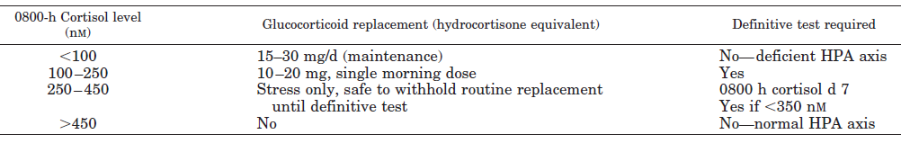
Who needs a definitive test of their HPA axis? (Cont’d)

Slide 52
Which test should be performed?
ITT
Overnight metyrapone test
Glucagon stimulation test
CRH test
ACTH 1–24 test (short synachten test)
Mean serum cortisol

Slide 53
Insulin Tolerance Test (ITT)
The gold standard test for normal HPA function
Despite a low incidence of serious adverse events, many clinicians are reluctant to subject their patients to ITT
ITT contraindication:
  IHD
  Arrhythmia
  Epilepsy
  Over-65 age(should be used with caution)
More time consuming for nursing and medical staff
Greater consumable and assay costs

Slide 54
Overnight metyrapone test
  30 mg/kg metyrapone taken at 2400 h, with food
  Plasma cortisol and 11-DOC are measured at 0800 h on the morning after metyrapone administration
  Normal response is 11-DOC level >200nm (7µg/dl)

Slide 55
Glucagon stimulation test
The recommended dose is 1 mg/im
The criteria for an adequate peak cortisol response is >500 nm (18 micg/dl)
CRH test:
  In the setting of pituitary disease is inferior to that of basal 0800 h cortisol
  Not recommend

Slide 56
ACTH 1–24 test (short synachten test)
  In the early postoperative period is not the investigation of choice (inability of this test to detect recent onset ACTH deficiency)
  Commonly, in North America, where access to metyrapone may be difficult, an ACTH 1–24 test is performed at the 6-wk time point

Slide 57
When is the optimal time to perform the test?
The literature is unable to give any fixed time-point.
Most studies that have examined the HPA axis by ITT or metyrapone testing between 7 and 14 d post surgery show a strong predictive value between these results and the need for long-term GC requirement.
Another alternative is to routinely perform a definitive dynamic test of pituitary function between 4 and 6 wk postoperatively

Slide 59
Preoperative
Hormonal Evaluation:
Adrenal
Thyroid
Gonad
GH axis
Prolactin
Replace thyroid and adrenal hormones if insufficincy detected prepoperatively
Transsphenoidal surgery
Perioperative stress dose steroids if indicated
Early Inpatient Monitoring
Outpatient Follow up
Early outpatient Assessment
Long Term Follow up
Assess:
Neurologic status
Diabetes insipidus
SIADH
1 week:
General status, Labs: sodium, cortisol
Hormonal status evaluation annually
or as dictated by clinical state
6 week:
General status and Hormonal Assessmetn (Adrenal, thyroid, gonad, GH axis, Prolactin as clinically indicated)
Assessment for tumor recurrence
12 week:
General status and Hormonal Assessment (Adrenal, thyroid, gonad, GH axis, prolactin as clinically indicated)
MRI – Baseline post op image
Assessment for biochemical remission in hormonally active tumors
American Association of Clinical Endocrinologist’ perioperative management of pituitary tumors.

Slide 60


