Slide 1
Dr.Zahra Davoudi
Endocrinology department and skull base research center of Loghman Hakim Hospital, Shahid Beheshti University of Medical Sciences

Slide 2
Agenda
Management of somatotroph adenoma , treatment paradigms
A look at new medical therapy and Personalized medicine approach
Genetic syndromes in pituitary adenoma

Slide 4
Presentation and management of comorbidities and mortality risk
We suggest evaluating all patients presenting with acromegaly for associated comorbidities, including hypertension, diabetes mellitus, cardiovascular disease, osteoarthritis, and sleep apnea
We also recommend that such comorbidities be longitudinally monitored and rigorously managed.
We suggest screening for colon neoplasia with colonoscopy at diagnosis.
We suggest a thyroid ultrasound if there is palpable thyroid nodularity.
We recommend assessing for hypopituitarism and replacing hormone deficits.
An Endocrine Society Clinical Practice Guideline, 2014

Slide 6
Management of Acromegaly

Slide 8
Management of Acromegaly
We recommend transsphenoidal surgery by an experienced neurosurgeon as the primary therapy in most patients.
We suggest that repeat surgery be considered in a patient with residual intrasellar disease following initial surgery.
An Endocrine Society Clinical Practice Guideline, 2014, consensus2018

Slide 9
Postoperative testing
Following surgery, we suggest measuring an IGF-1 level and a random GH at 12 weeks or later
We also suggest measuring a nadir GH level after a glucose load in a patient with a GH greater than 1ug/L.
We recommend performing an imaging study at least 12 weeks after surgery to visualize residual tumor and adjacent structures
We suggest MRI as the imaging modality of choice followed by CT scan when MRI is contraindicated or unavailable.
An Endocrine Society Clinical Practice Guideline, 2014

Slide 10
Treatment Aims
In controlled patient GH levels should be suppressed to at least 1 μg/L or less after an oral glucose load, and age matched and gender-matched serum IGF1 levels should be normalized.
A Consensus Statement on acromegaly therapeutic outcomes Shlomo Melmed et al. Nature Reviews , Endocrinology,2018

Slide 12
Ideally, the goal of therapy should be tight control of GH secretion and normalization of IGF1 levels,
Discordant reported IGF1 and GH values have been observed in patients following surgery as well as in those treated with somatostatin receptor ligands (SRLs)
Discordant GH and IGF1 results after treatment should necessitate repeating the respective assay(s) in a reputable laboratory using rigorous assay standardizations and appropriate sensitivity cutoffs.
IGF-I levels measured 6 weeks postoperatively can be used in most patients to assess remission, although patients with mildly elevated IGF-I may yet normalize by 3–6 months.
GH nadir levels during an OGTT are also affected by factors such as patient age, BMI, sex and oestrogen use, and we recommend that these factors are considered when interpreting results of this test
Reference GH nadir levels after OGTT using the IDS-iSYS assay accounting for BMI, sex, and ethinyle stradiol-containing oral contraceptive use confirm the importance of these factors as confounders in GH measurements.
Bidlingmaier M, Friedrich N, Emeny RT, et al. Reference intervals for insulin-like growth factor-1 (IGF-I) from birth to senescence: results from a multicenter study using a new automated chemiluminescence IGF-I immunoassay conforming to recent international recommendations. J Clin Endocrinol Metab. 2014;99:1712–1721.,
A Pituitary Society update to acromegaly management guidelines Maria Fleseriu1 Pituitary 2020

Slide 13
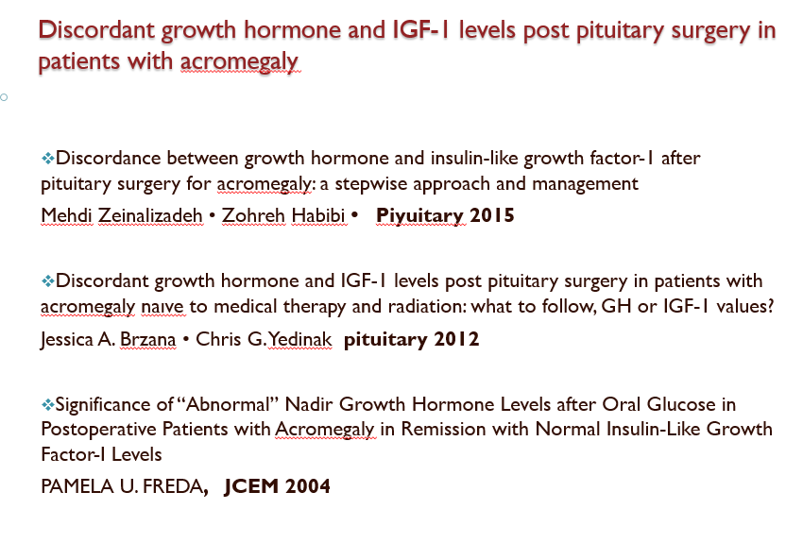

Slide 15
IGF1 assays
IGF1 is a valid indicator of disease activity and GH status in acromegaly, but its clinical use has met some objections and restrictions.
IGF1 is the most sensitive and specific test for the diagnosis of acromegaly, total reliance on it for diagnosis or using it as the sole indication of disease severity and GH burden is not recommended.
Due to wide range of “normal” IGF-I levels, we cannot exclude the possibility that an IGF-I within the normal reference range may not be truly normal for some individuals.

Slide 16
Factors affecting serum IGF1 level
Factors decreasing serum level
Progressive liver and Renal disease
Nutritional and gastrointestinal disease
Serious coexisting illness
Hypothyroidism
Poorly controlled type I diabetes mellitus
Prolonged fasting
Oral estrogen consumption
Alcohol consumption
Factors increasing serum level
Puberty
Pregnancy
Testosterone and DHEAS

Slide 17
Physiological and pathological factors affecting serum GH
Puberty
Pregnancy
Hepatic and renal failure
Long term starvation
Malnutrition
Poorly controlled diabetes mellitus
Physical and emotional stress
Genetic factors
Thyrotropin releasing hormone (TSH)
Glucocorticoids
Opioids
Exogenic estrogen
Endogenic estrogen
Testosterone therapy

Slide 18
Algorithm for Approach to discordance between GH and IGF1 after surgery

Slide 19
Approach to postoperative GH and IGF1 discordance
1 ) In those with mean diurnal GH less than 1ug/l and normal or mildly supra normal IGF1 values,, regular follow up similar to subjects in remission seems reasonable.
2 ) In cases with mean diurnal GH more than 1ug/l and normal IGF1, in the absence of clinical symptoms and signs, close clinical follow up and biochemical evaluation every 3–6 months is justified.
3 ) In the presence of elevated IGF1 and clinical signs and symptoms, pharmacological medications should be individualized.

Slide 21
Key 2018 consensus recommendations
A Consensus Statement on acromegaly therapeutic outcomes Shlomo Melmed et al. Nature Reviews , Endocrinology,2018

Slide 26
Radiotherapy
We suggest use of radiation therapy in the setting of residual tumor mass following surgery, and if medical therapy is unavailable, unsuccessful, or not tolerated.
We suggest use of stereotactic radiotherapy (SRT) over conventional radiation therapy in patients with acromegaly, unless the technique is not available, there is significant residual tumor burden, or the tumor is too close to the optic chiasm resulting in an exposure of more than 8 Gy.
To monitor the efficacy of radiation therapy, we recommend annual GH/IGF-1 reassessment following medication withdrawal.
We recommend annual hormonal testing of patients following RT for hypopituitarism and other delayed radiation effects.

Slide 30
Personalized medicine in the treatment of acromegaly
Personalized medicine in the treatment of acromegaly Leandro Kasuki et al. European Journal of Endocrinology (2018)

Slide 33
Is pituitary adenoma hereditary?

Slide 34
Genetic aspect of pituitary adenoma
Most pituitary adenomas are sporadic and histologically benign; nevertheless, they can cause significant burden due to hormonal hypersecretion and tumor mass effects.
Both gene expression changes and genetic alterations, including germline (for example MEN1 and AIP genes) or somatic (for example in GNAS or USP8 genes) mutational events, can be identified in pituitary adenomas.
Five percent of the pituitary adenomas arise in a familial setting occurring either isolated or as part of a syndrome.
Isolated pituitary adenomas can be observed in AIP gene mutation-positive cases and in X-linked acrogigantism due to GPR101 duplications, but in most familial isolated pituitary adenomas, the disease-causing mutations have not been identified.
Syndromic presentations occur in MEN1, MEN4, Carney complex, McCune-Albright syndrome, and rarely, mutations in DICER1 and SDH genes can also predispose to pituitary adenomas
Pedro Marques, MD, Márta Korbonits, MD, PhD. Genetic aspect of pituitary adenoma, Endocrinol Metab Clin N Am - (2017)

Slide 35
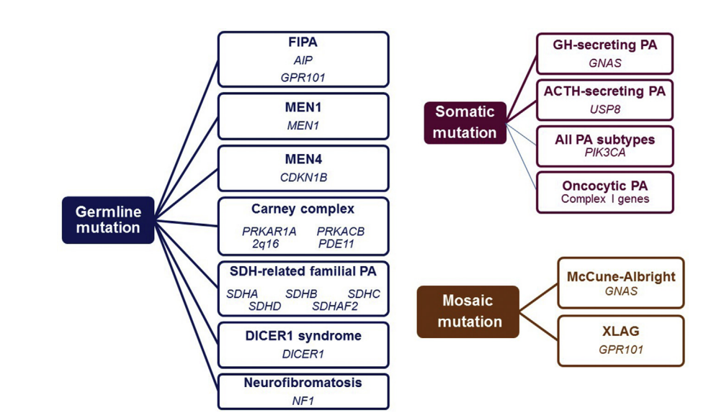
Pituitary tumors due to genetic origin

Slide 36
Genes Associated With Familial Pituitary Tumor Syndromes

Slide 37
approach for genetic testing
Pedro Marques, MD, Márta Korbonits, MD, PhD. Genetic aspect of pituitary adenoma, Endocrinol Metab Clin N Am - (2017)

Slide 38
Take home message
Genetic screening and clinical follow-up of carriers may lead to better long-term outcomes, whereas better understanding of pituitary tumorigenesis can lead to further improvements in terms of diagnosis, treatment, and follow-up for both familiar and sporadic cases of PAs

